Slide 1
Pedestrian tracking
VUT FIT POVa
Lukáš Petrovič, Filip Šťastný, Martin Vondráček
2019-01-09

Slide 2
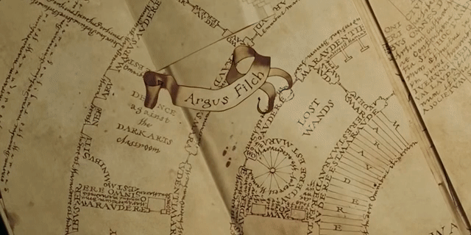

Task Inspiration
Marauder's Map from Harry Potter
Magic parchment that reveals the current location of anyone on Hogwarts grounds
http://harrypotter.wikia.com/wiki/Marauder%27s_Map

Slide 3
Task definition
Multiple people walking in a scene
Multiple stationary cameras
Initial calibration
Individual path tracking

Slide 4
Processing pipeline

Slide 5
Processing pipeline

Slide 6
Processing pipeline

Slide 7
Processing pipeline

Slide 8
Processing pipeline

Slide 9
Processing pipeline

Slide 10
Processing pipeline

Slide 11
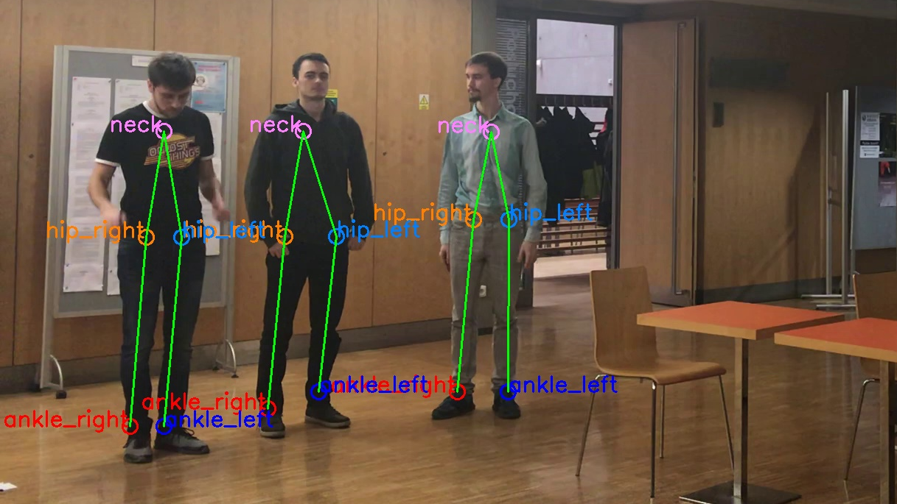
Human Detection in 2D
OpenPose deep neural network
Pretrained model with COCO dataset
Multi-person key point detection

Slide 12
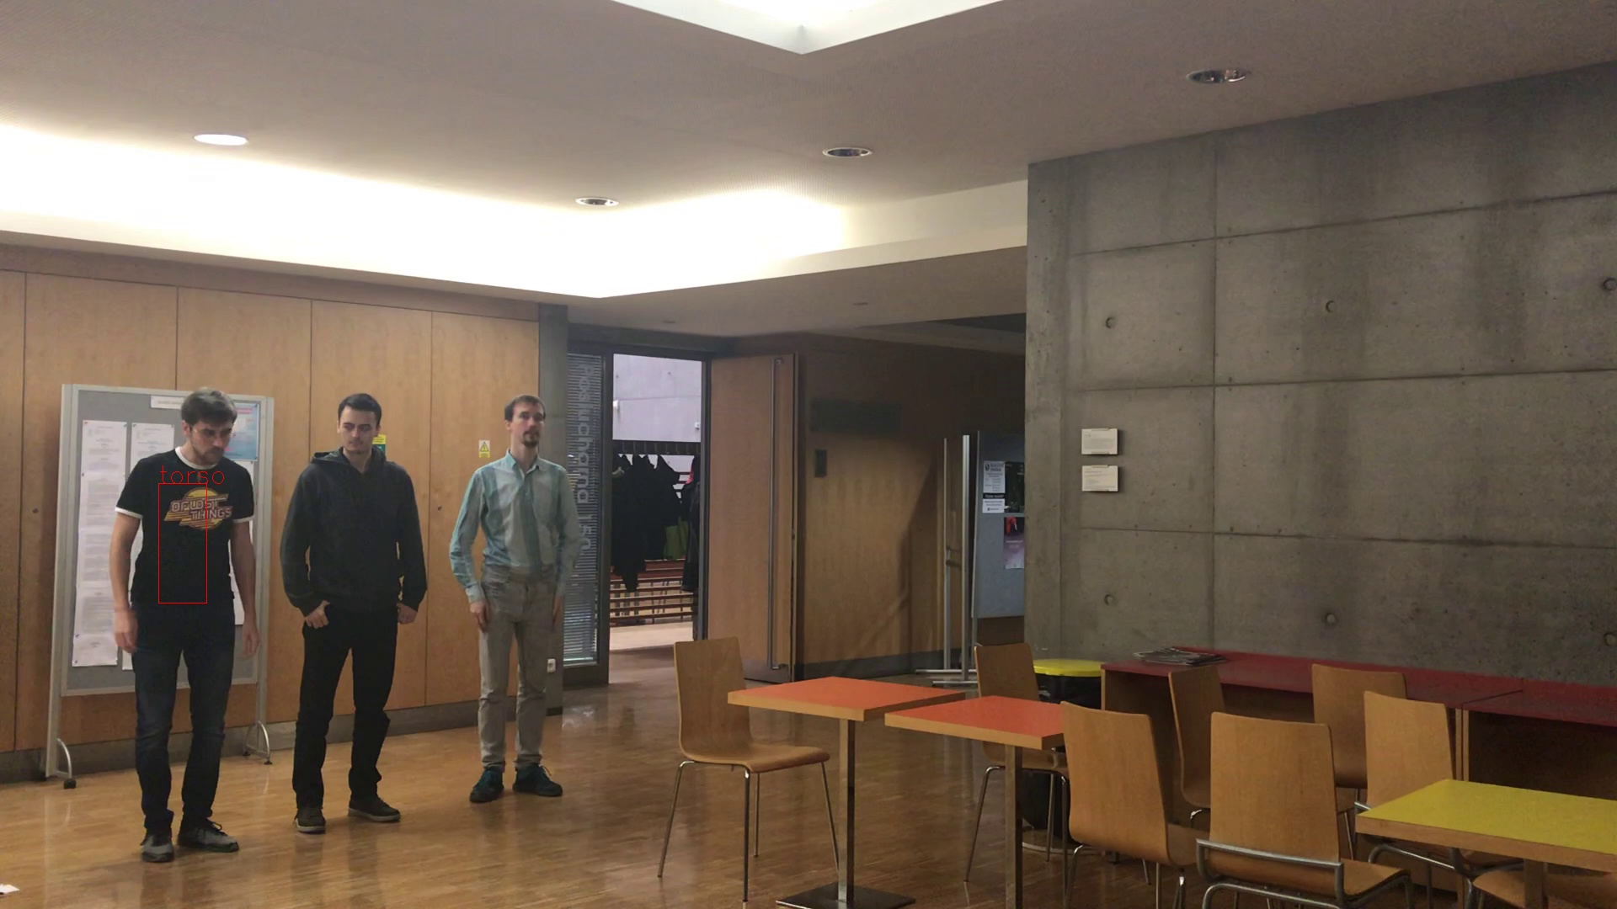
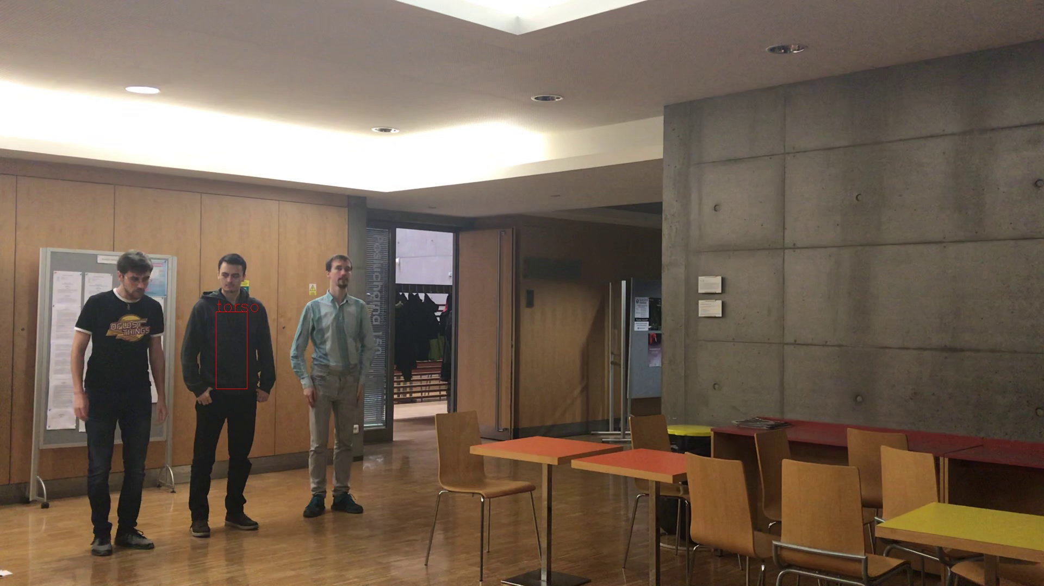

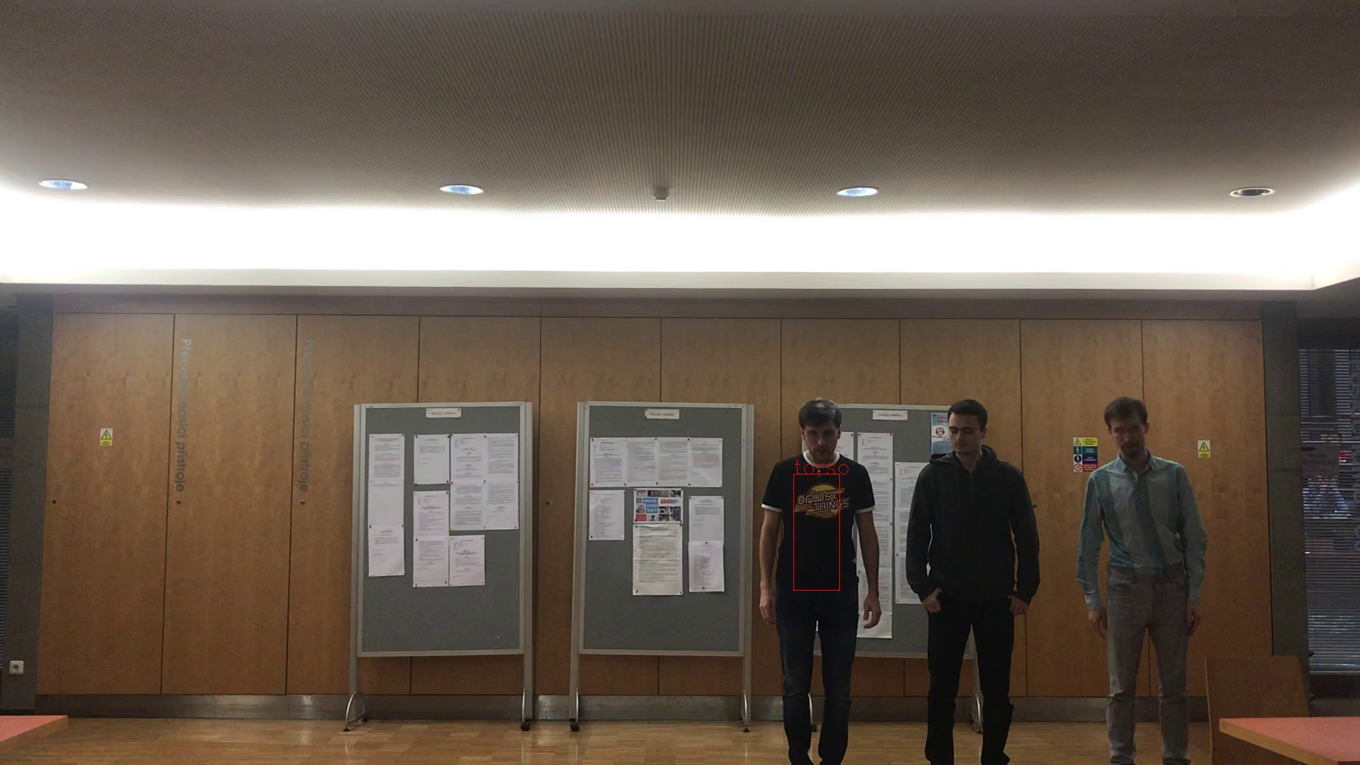


Person View Matching
Similar torso histograms → same person
Side person views
Front person views

Slide 13
Person View Matching
Similar torso histograms → same person
PersonTimeFrame A
PersonTimeFrame B
PersonTimeFrame C

Slide 14
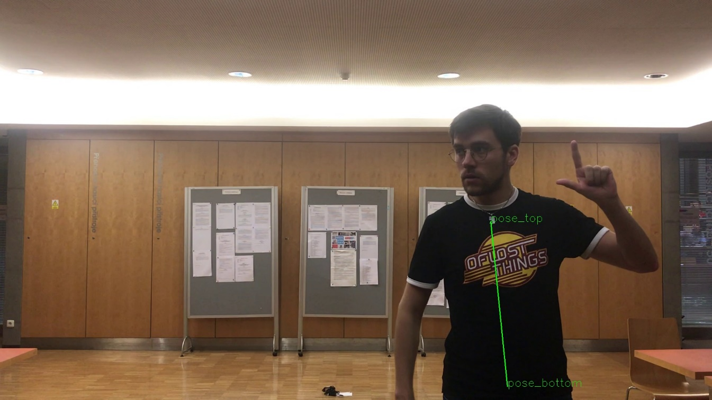
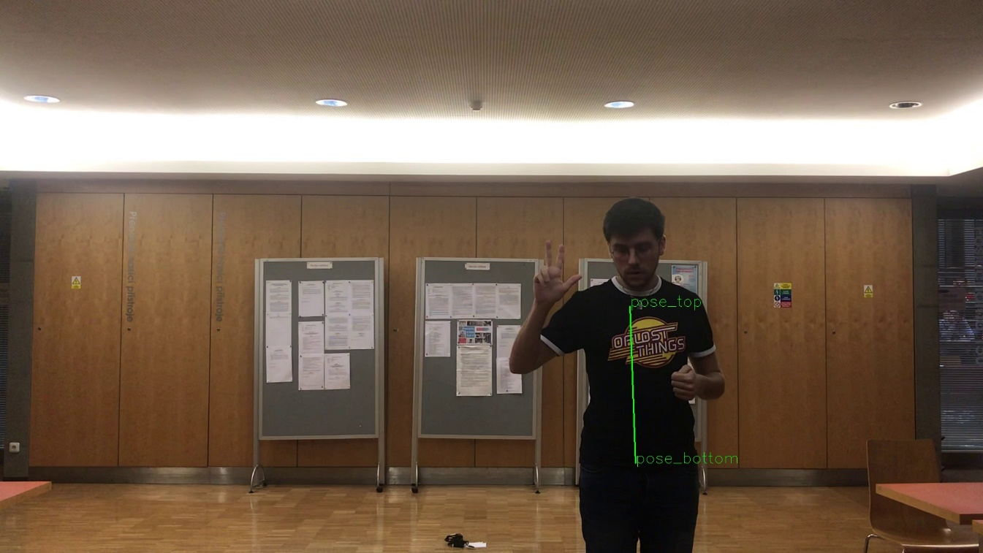
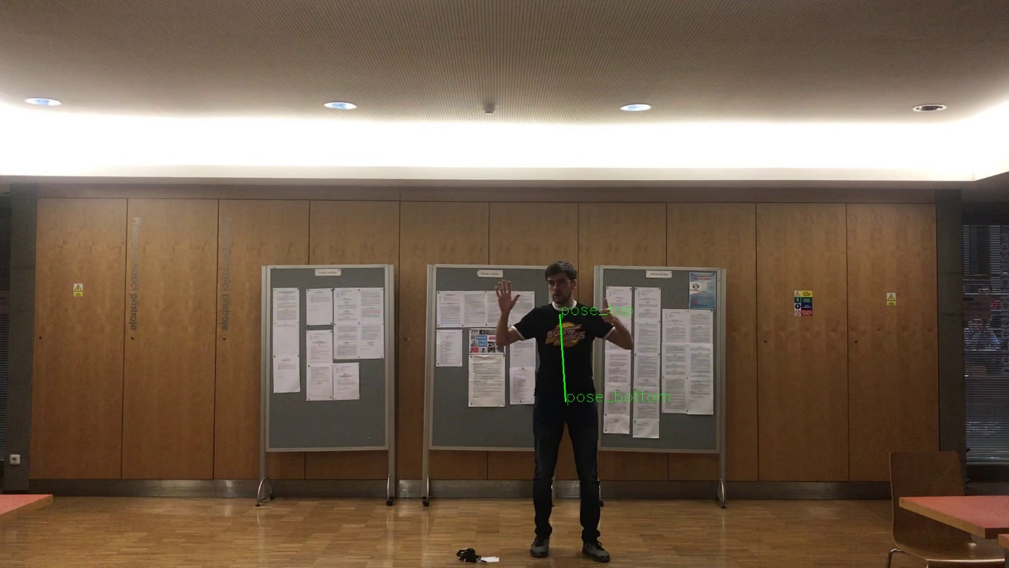
Triangulation
Average person’s torso → distance from camera
y = 2 m
y = 3 m
y = 6 m

Slide 15
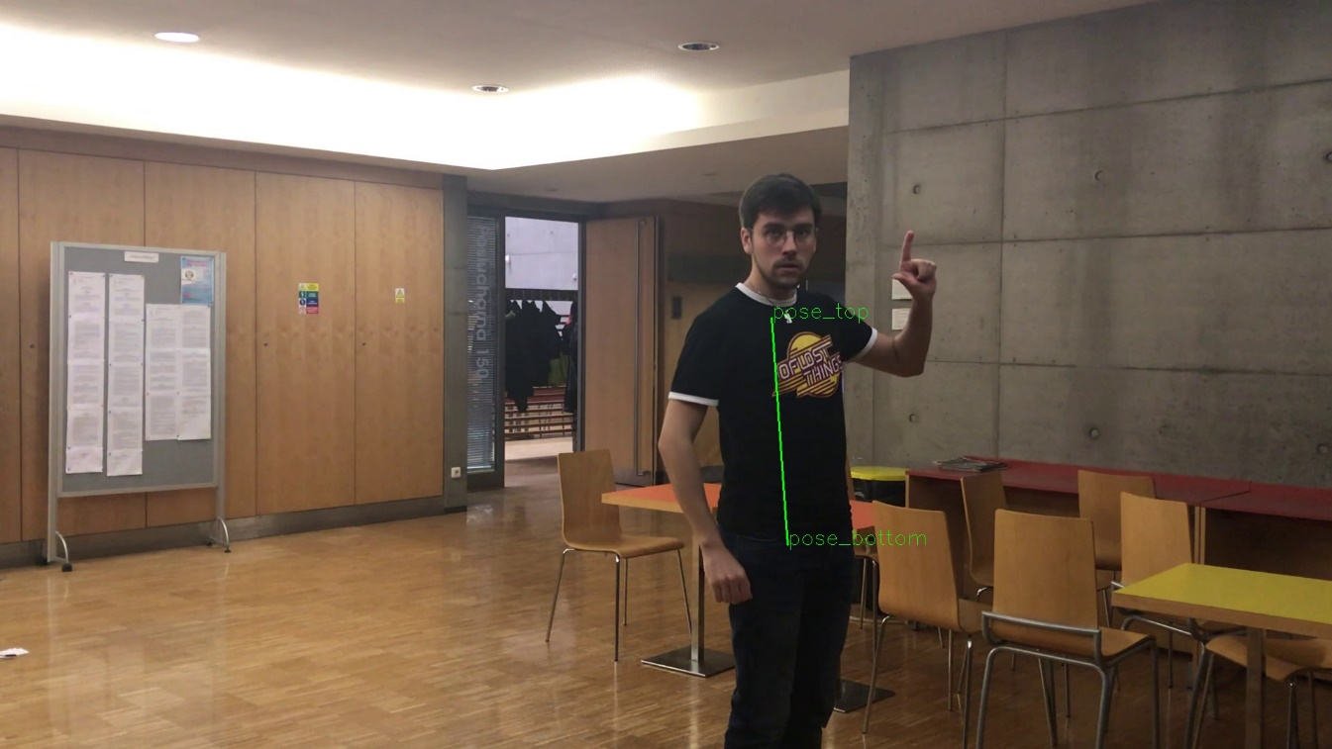
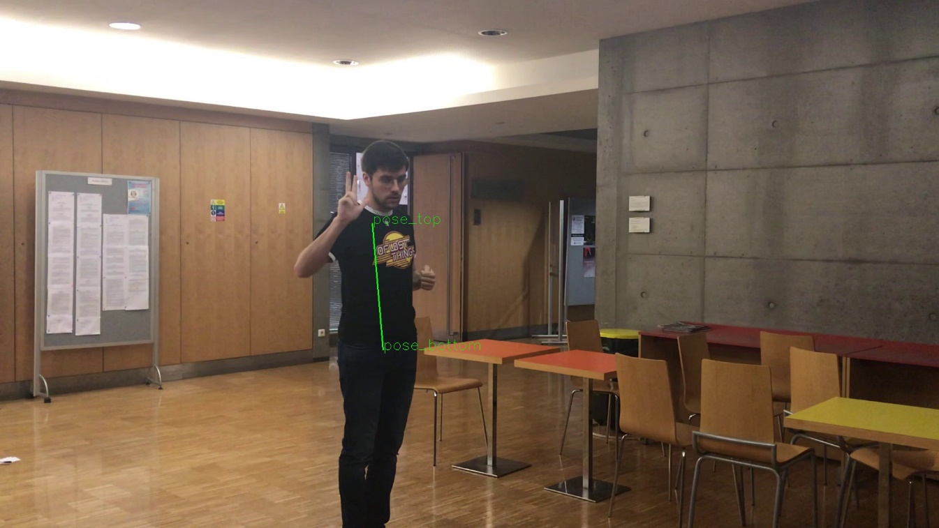
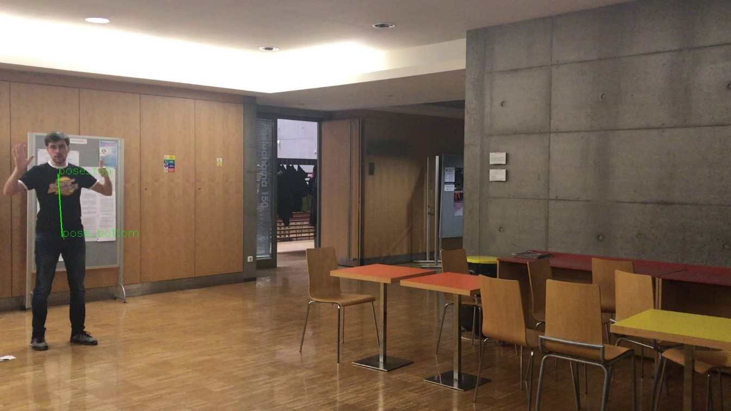
Triangulation
Average person’s torso → distance from camera
y = 2 m
y = 3 m
y = 6 m

Slide 16
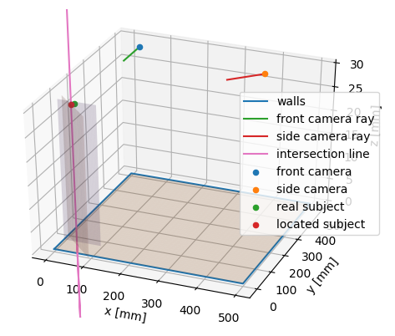
Triangulation
Intersection of distance planes → person‘s position

Slide 17
Person Tracking
Similar torso histograms over time → same person
Tracker

Slide 18
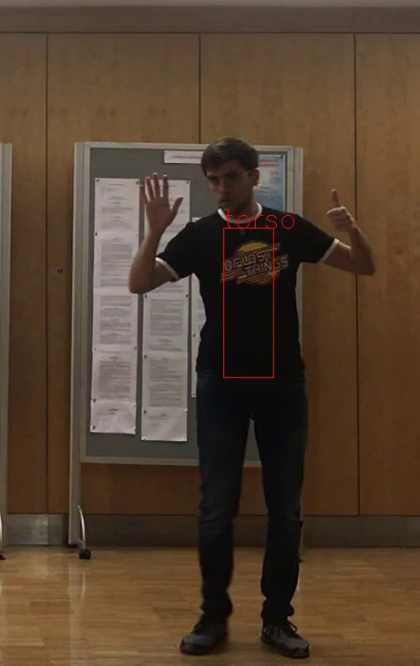
Person Tracking
Similar torso histograms over time → same person
Tracker

Slide 19

Person Tracking
Similar torso histograms over time → same person
New person!
Tracker
Person 1

Slide 20
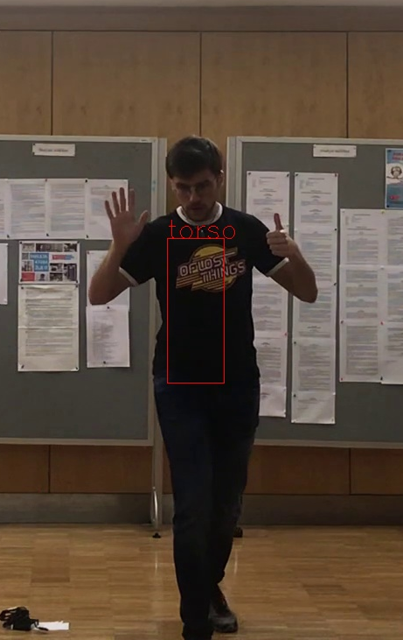
Person Tracking
Similar torso histograms over time → same person
Tracker
Person 1

Slide 21
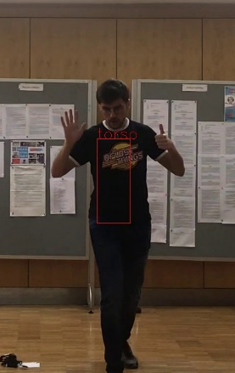
Person Tracking
Similar torso histograms over time → same person
Known person!
Tracker
Person 1

Slide 22
Person Tracking
Similar torso histograms over time → same person
Tracker
Person 1

Slide 23
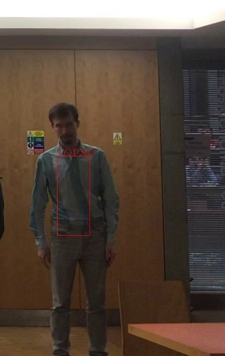
Person Tracking
Similar torso histograms over time → same person
New person!
Tracker
Person 1
Person 2

Slide 24
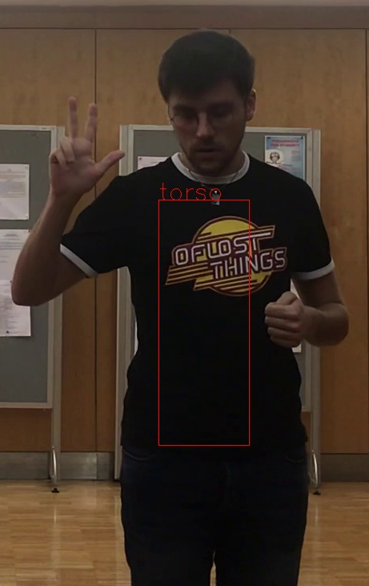
Person Tracking
Similar torso histograms over time → same person
Tracker
Person 1
Person 2

Slide 25

Person Tracking
Similar torso histograms over time → same person
Known person!
Tracker
Person 1
Person 2

Slide 26
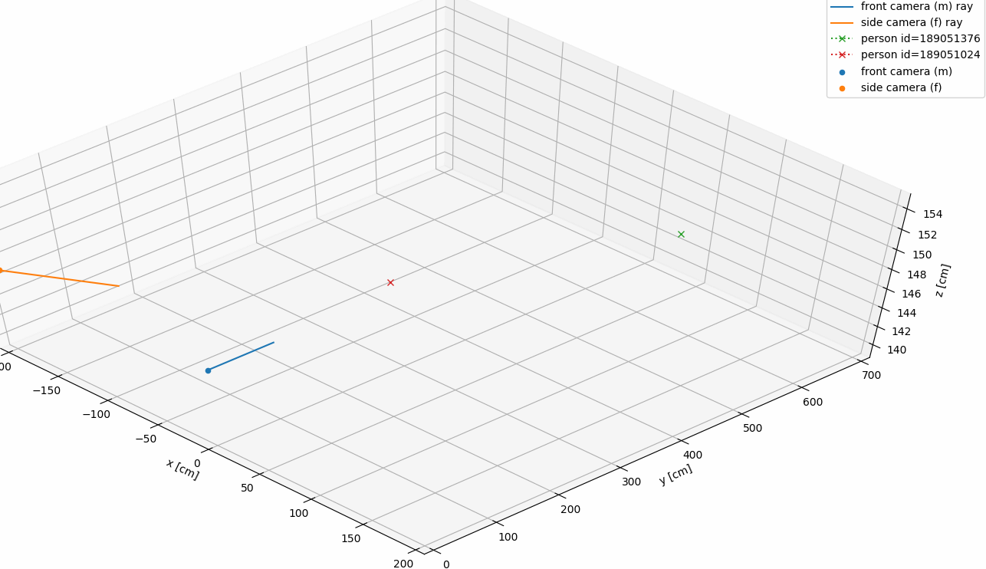
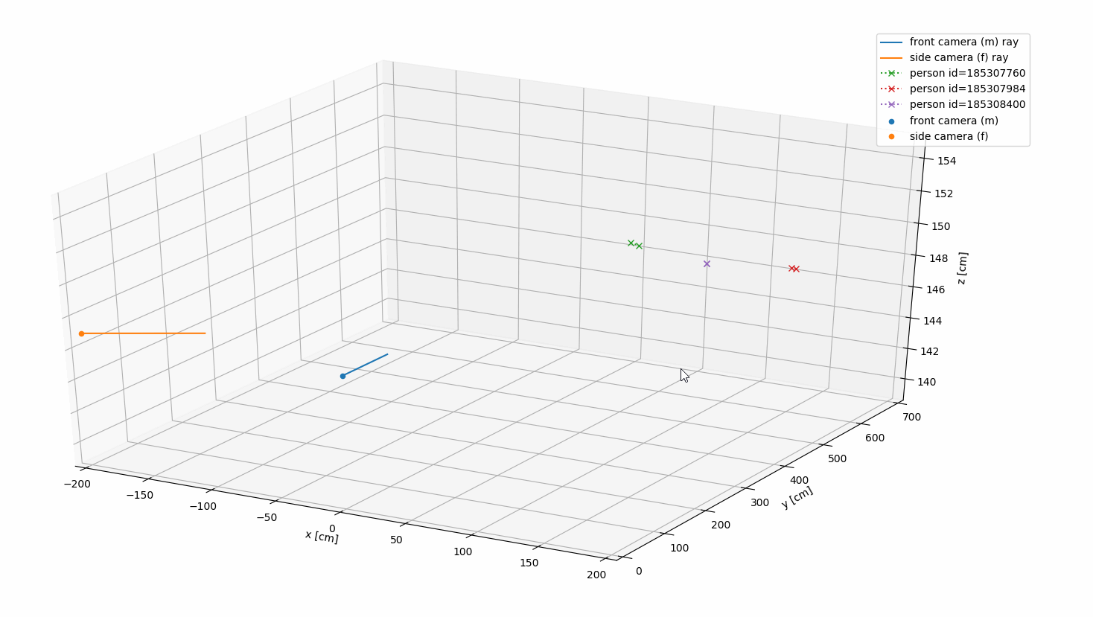
Visualisation
Paths of all tracked people, positions of cameras
Interactive 3D model

Slide 27
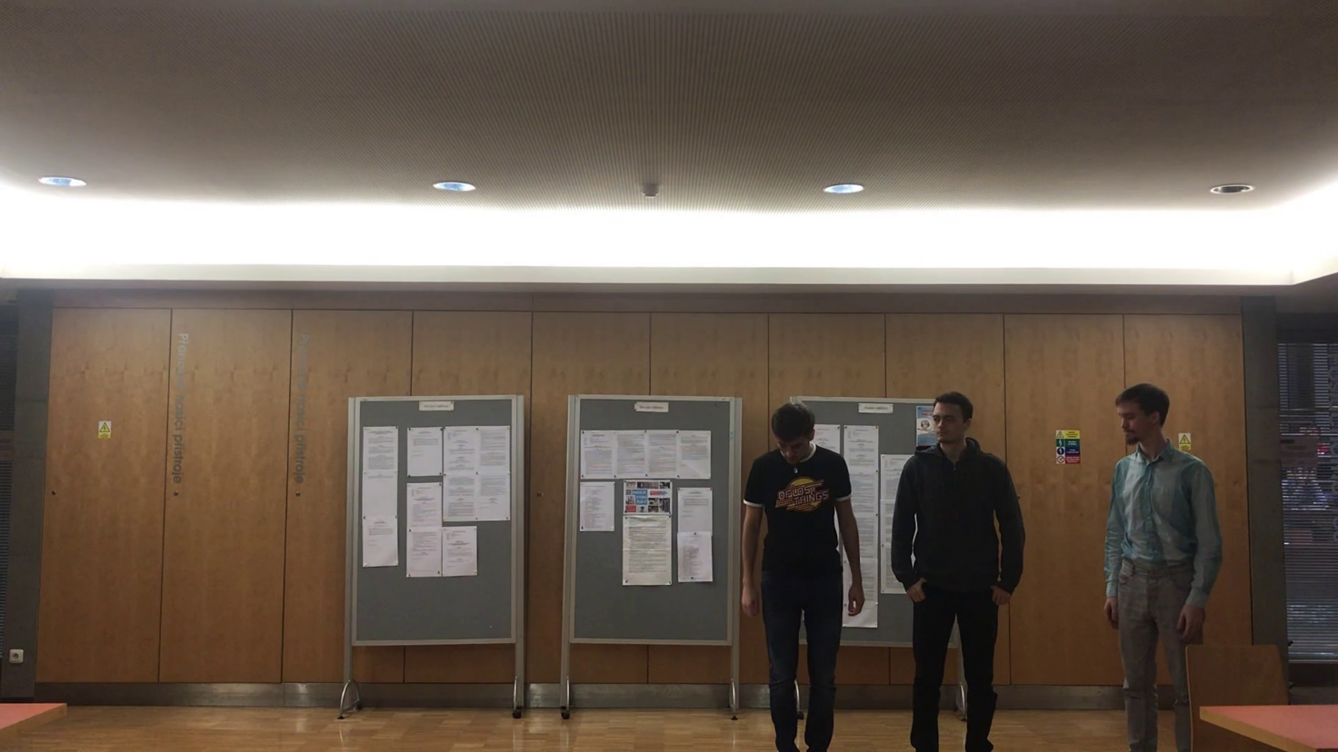
Testing Data
Own images and videos
COCO dataset for OpenPose

Slide 28
Evaluation
* GPU binary start-up time: 2.1 s, CPU binary start-up time: 3.4 s.

Slide 29
Evaluation
215 ms
* GPU binary start-up time: 2.1 s, CPU binary start-up time: 3.4 s.

Slide 30
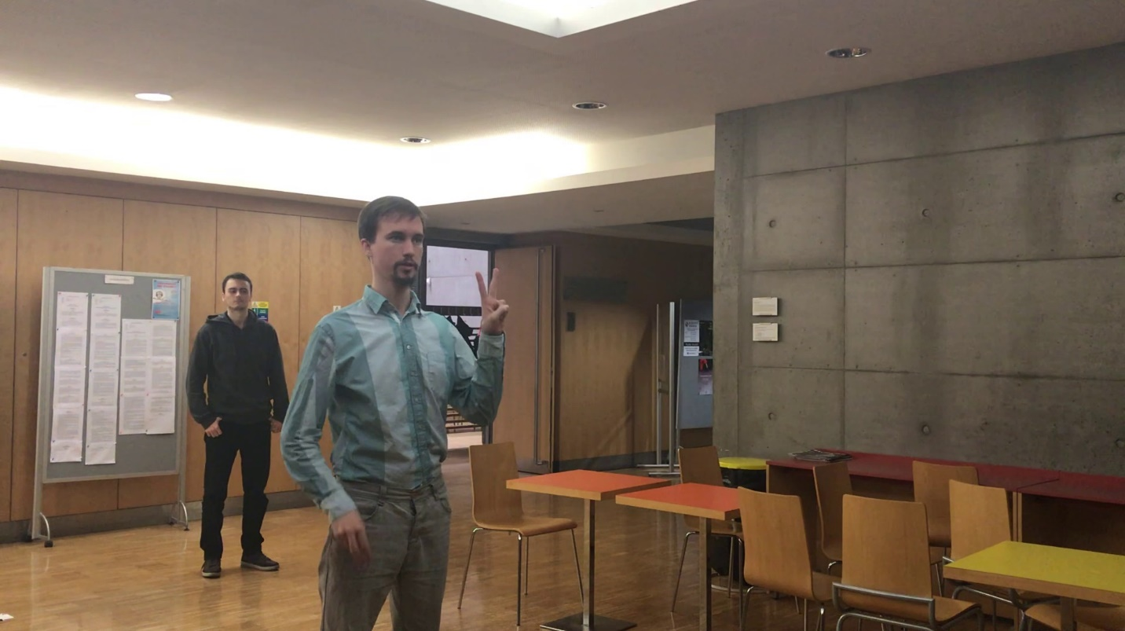
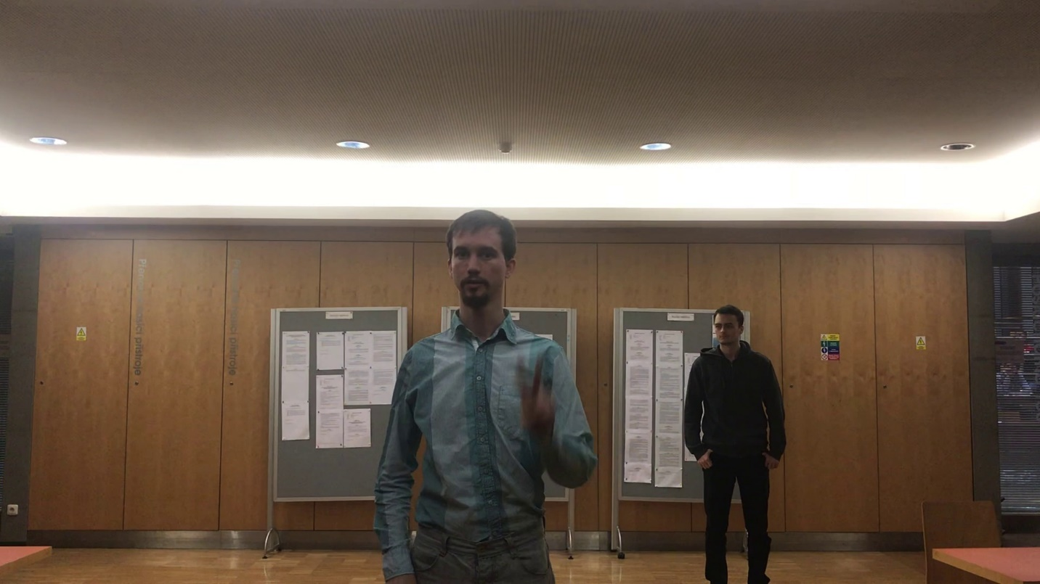


Evaluation
Image preprocessing → stable matcher and tracker
Side original
Front original

Slide 31
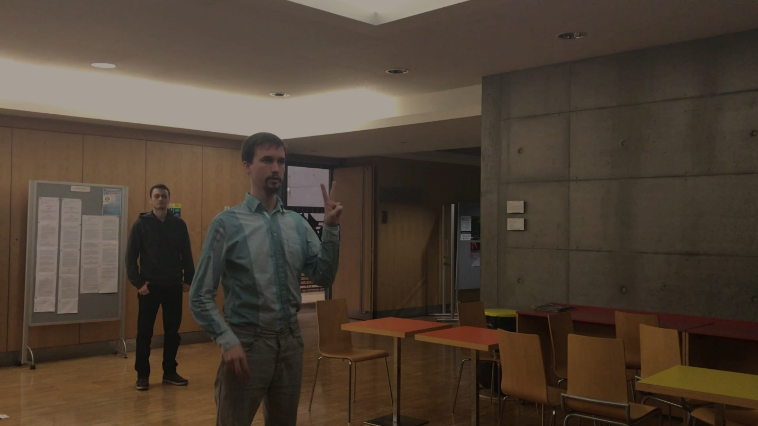


Evaluation
Image preprocessing → stable matcher and tracker
Side preprocessed
Front preprocessed

Slide 32
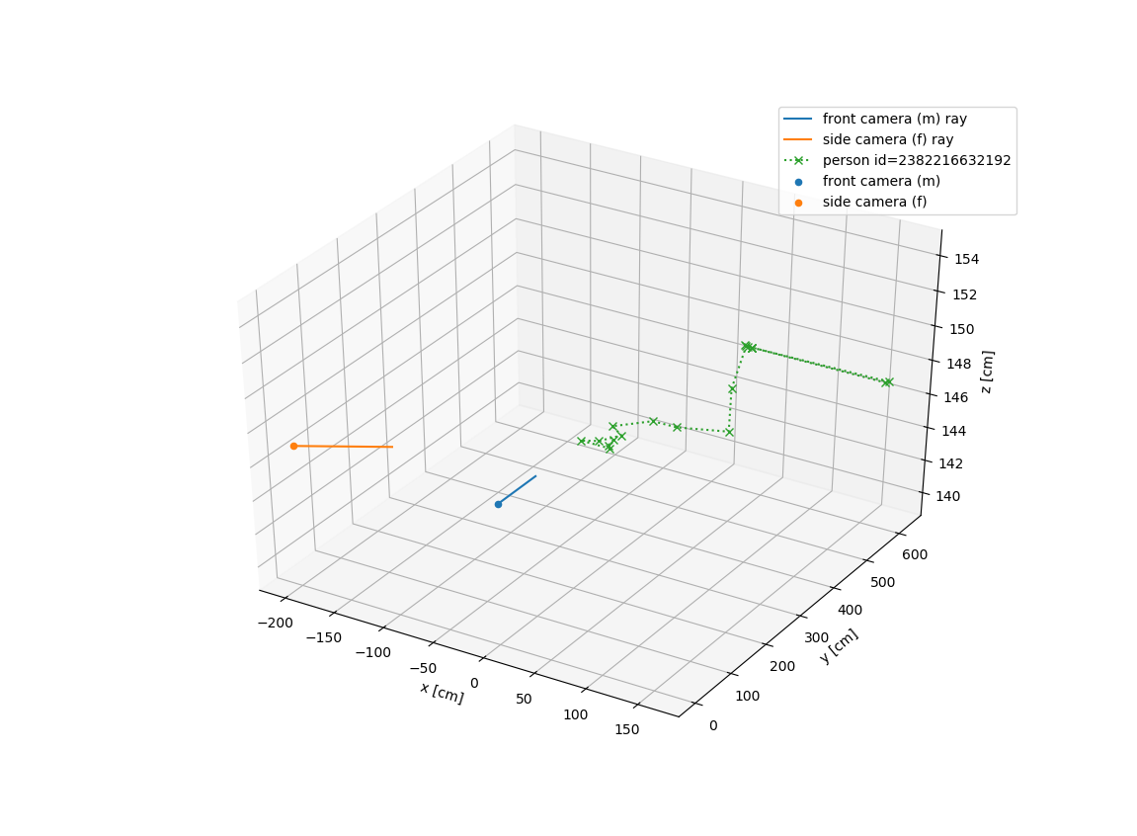
Evaluation
Matching torso (t-shirt) based
Triangulation worst case less than 35 cm error in 600 cm space.
Tracking similarity threshold

Slide 33
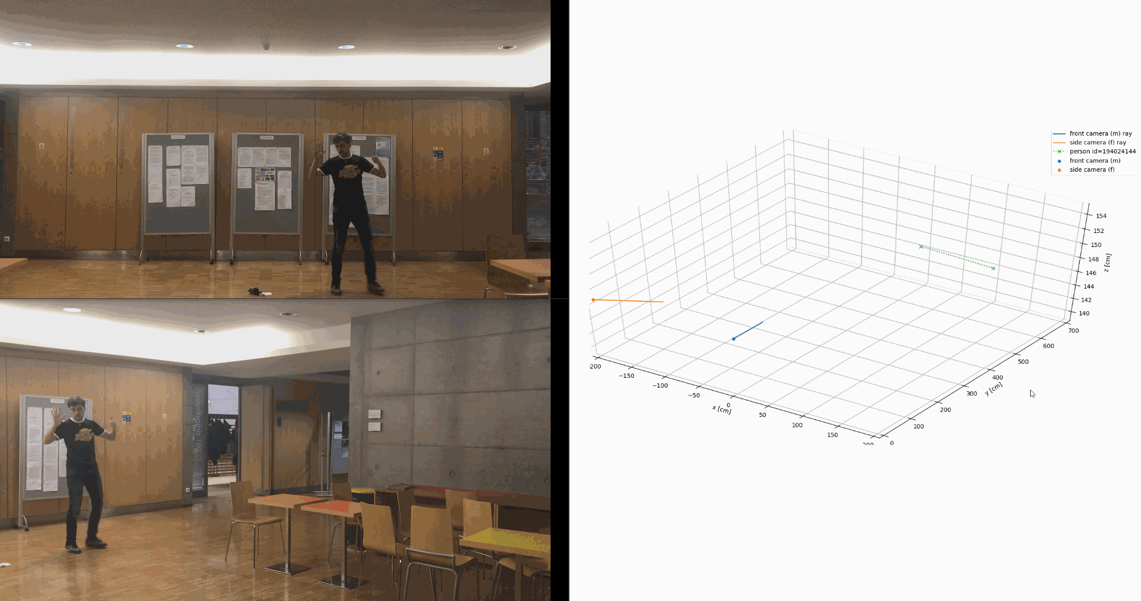
Thank you for your attention.
Pedestrian tracking

